Slide 1
Distributions

Slide 2
Random Variable

Slide 3
Random Variable
What is Random Variable
Types of Random Variable
Discrete Random Variable
Continuous Random Variable

Slide 4
Random Variable
A random variable is a numerical description of the outcome of an experiment.
An experiment’s outcome may or may not be a numerical value
Random variable is a method to transform the outcome of an experiment into a numerical value.
The outcome of throwing a die is already in numerical form. The number so obtained {0,1,2,3,4,5,6} is a random variable.
A successful or unsuccessful sales call resulting in an order or no order may not be readily expressed in numerical terms. In such case we transform x=0 as failure to secure an order and x=1 as successfully securing an order.
A discrete random variable can assume only finite number of numerical values. Eg: Number of questions answered by a student in an examination.
A continuous random variable can assume infinite number of numerical values. These experimental outcomes are based on interval or ratio scale. Eg: flight time to Delhi.

Slide 5
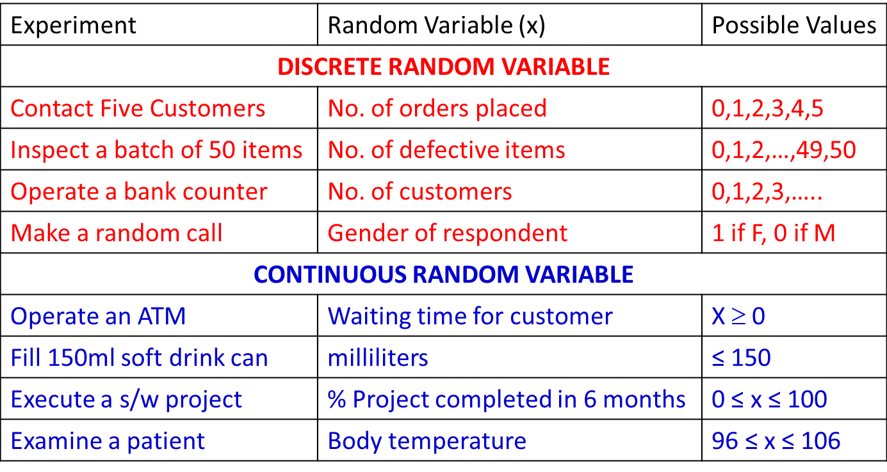
Random Variable Examples

Slide 6
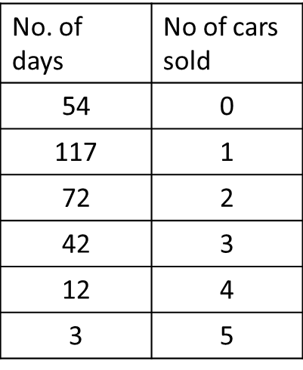
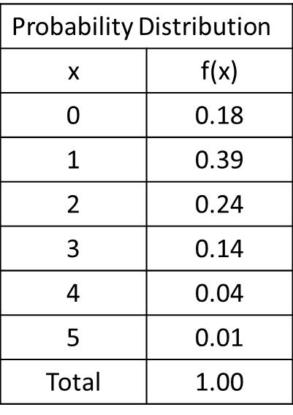
Discrete Probability Distribution
A probability distribution for a random variable describes how probabilities are distributed for different values assumed by the random variable.
For a discrete random variable it is defined by a probability function denoted by f(x).
A car dealer worked for 300 days last year. The number of cars sold each day is given below:

Slide 7
Graphical Representation of Discrete Probability Distribution

Slide 8
Conditions for Discrete Probability Distribution
f(x) ≥ 0
Σ f(x) = 1
For a Discrete uniform probability distribution
f(x) = 1/n for x = 1,2, …, n
Discrete probability distribution may be described by a formula that satisfies conditions above.
f(x) = x/10 for x = 1,2,3,4
Examples of discrete probability distributions
Binomial distribution
Poisson distribution
Mean or Expected value of a discrete random variable
E(x) = μ = Σ xf(x)
Variance of a discrete random variable
Var(x) = σ² = Σ (x- μ)²f(x)

Slide 9
Continuous Random Probability
A random variable that may assume any numerical value in an interval or collection of intervals is
called a continuous random variable.
For a continuous random variable
The probability at any point is 0. (Area under curve only makes sense)
probability for a given interval.
The cumulative probability is equal to 1 i.e. sample space.
The probability density can never be negative.
The probability density can exceed 1.
Area is a measure of probability.

Slide 10
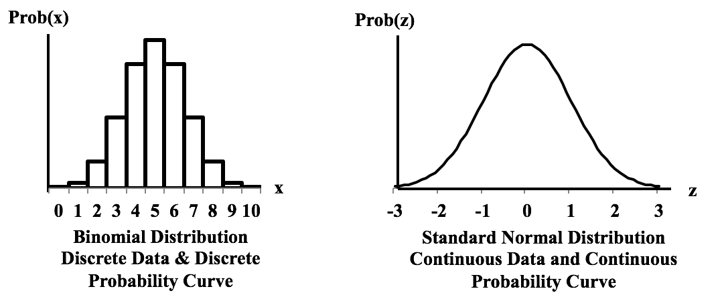
Discrete Vs Continous

Slide 11
Discrete Random Variable

Slide 12
Binomial Probability Distribution
It is a discrete probability distribution. It is associated with multistep experiment that we call binomial experiment
Properties (or assumptions) of binomial experiment
The experiment consists of a sequence on n trials.
Only two outcomes are possible in each trial. We refer to one of them as “success” and the other as “failure”.
The probability of success is denoted by p, does not change from trial to trial. Consequently, the probability of failure is given by (1-p) and does not change from trail to trail.
The trials are independent.
If properties 2, 3, and 4 are present, we say the trials are generated by a Bernoulli process
In a binomial experiment we are interested in the distribution of 0 to n successes in n trials.

Slide 13
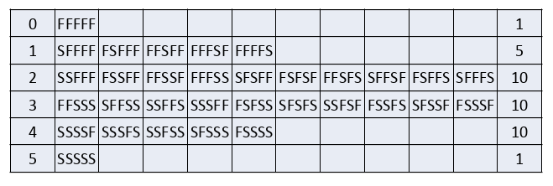
Binomial probabilities for 5 trial experiment
ALL OUTCOMES
FFFFF | FSFFF | SFFFF | SSFFF
FFFFS | FSFFS | SFFFS | SSFFS
FFFSF | FSFSF | SFFSF | SSFSF
FFFSS | FSFSS | SFFSS | SSFSS
FFSFF | FSSFF | SFSFF | SSSFF
FFSFS | FSSFS | SFSFS | SSSFS
FFSSF | FSSSF | SFSSF | SSSSF
FFSSS | FSSSS | SFSSS | SSSSS
NO OF SUCCESSES
x | Frequency Form table | ⁵C_{x} | Probability
0 | 1 | 1 | 0.03125
1 | 5 | 5 | 0.15625
2 | 10 | 10 | 0.31250
3 | 10 | 10 | 0.31250
4 | 5 | 5 | 0.15625
5 | 1 | 1 | 0.03125

Slide 14
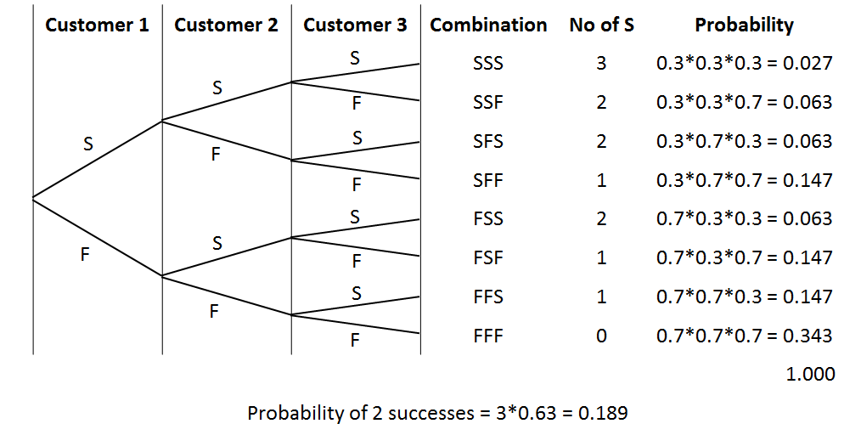
Martin Cloth store problem
On the basis of past experience martin cloth store manager estimates that the probability of purchase by any customer is 0.3 and purchase decision of one customer does not influence the other. What is the probability of 2 of
the next three customers will make a purchase?
3 *P^2 * (1-p)

Slide 15
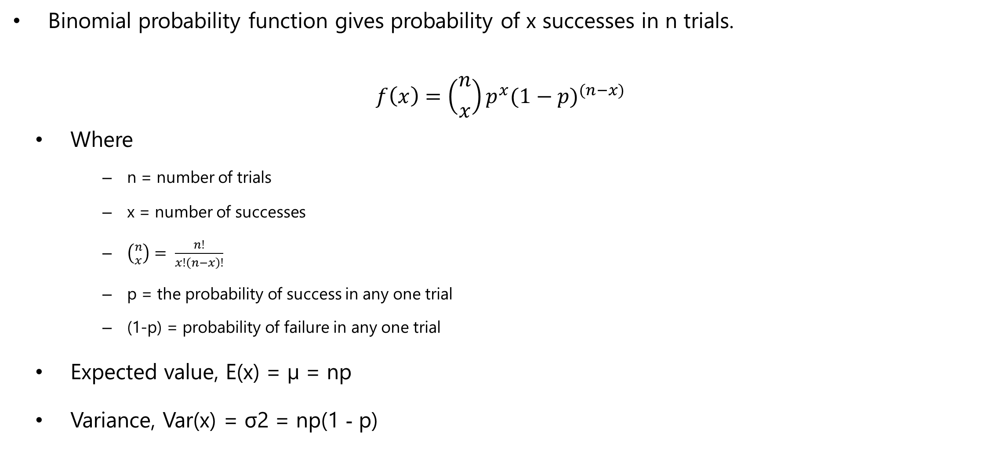
Binomial Probability Function

Slide 16
Bernoulli Process
Each trial of a binomial experiment is a Bernoulli process.
A Bernoulli process is a single trial resulting in either a success S = 1 or a Failure F = 0.
Probability of success s is p and that failure F is (1-p)
The Expected value / mean of Bernoulli experiment is 1*p + 0*(1-p) = p
The variance of Bernoulli trial is
Var(x) = p (1-p)2 + (1-p)(0-p)2 = p –p3 –p2 + p3 = p(1-p)
Please note
μ _{x±y} = μ_{x}± μ_{y}
σ²_{x±y} = σ²_{x} + σ²_{y}

Slide 17
Bernoulli Process
A binomial experiment is a series of n Bernoulli trials. Therefore
μx = p + p + … n times = np
Let (1-p) = q then
For a Bernoulli trial
Var(b) = pq
For n trials
Var(x) = pq + pq + … n times = npq = np(1-p)

Slide 18
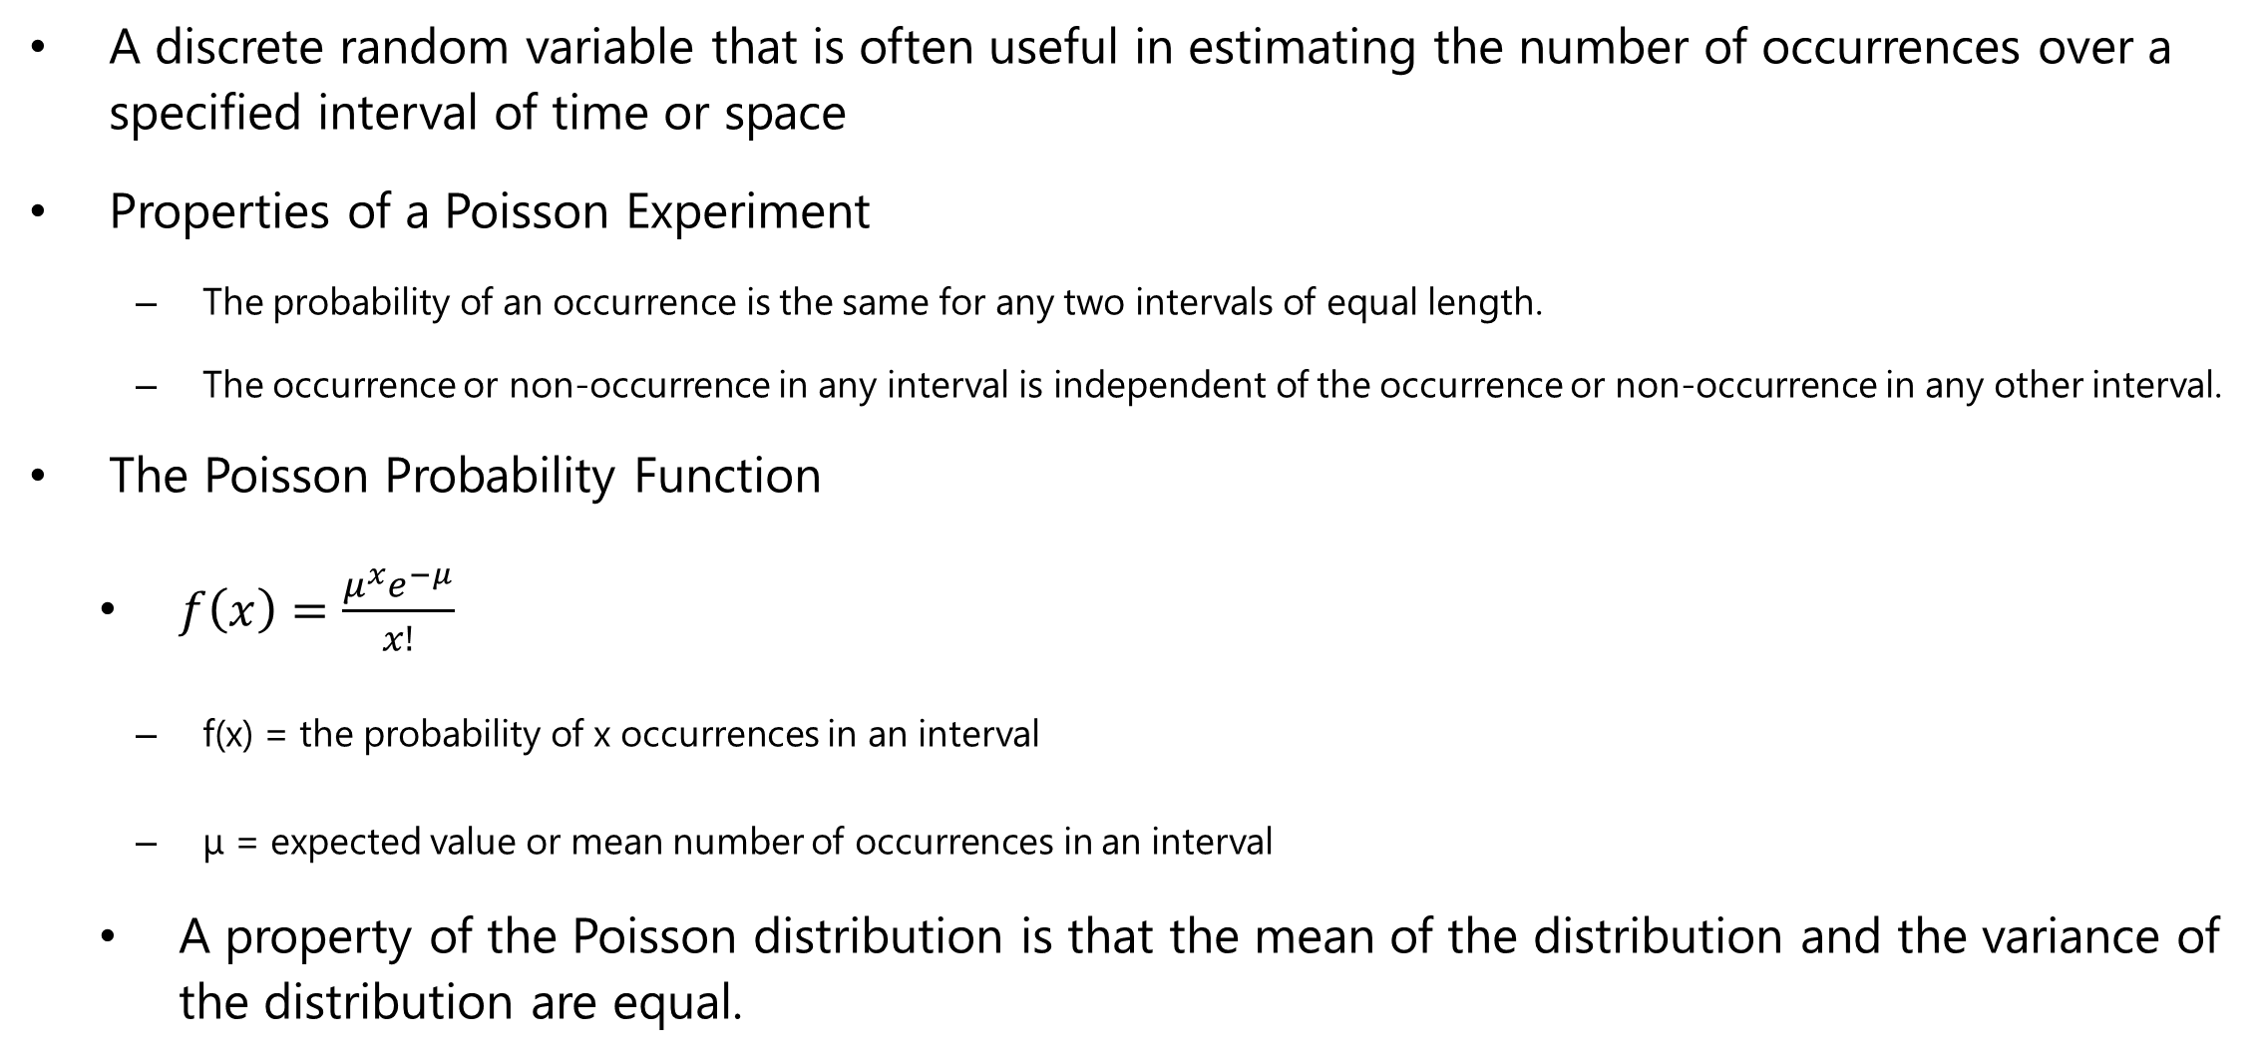
Poisson Probability Distribution

Slide 19
Poisson Probability Distribution
Business Examples:
No. of persons arriving at a service station or ATM
No. of calls coming to a call center in an given interval.
No. of defects in a length of cloth from a loom
No. of accidents in a given length of highway.

Slide 20
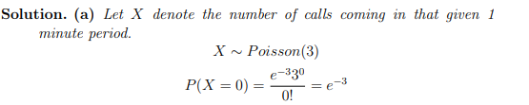
Poisson Probability Distribution - Example
Example :The number of calls coming per minute into a hotels reservation center is Poisson random variable with mean 3.
Find the probability that no calls come in a given 1 minute period

Slide 21


Uniform
The uniform distribution is a continuous probability distribution and is concerned with events that are equally likely to occur.
The probability distribution function of the continuous uniform distribution is:

Slide 22
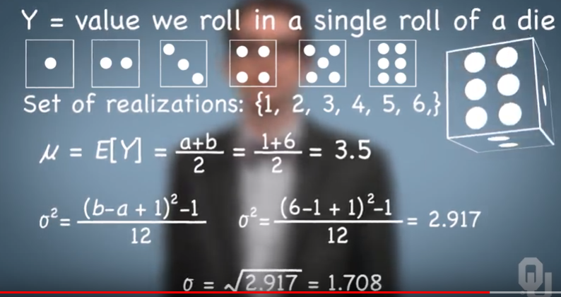

Slide 23
Continuous Random variable

Slide 24
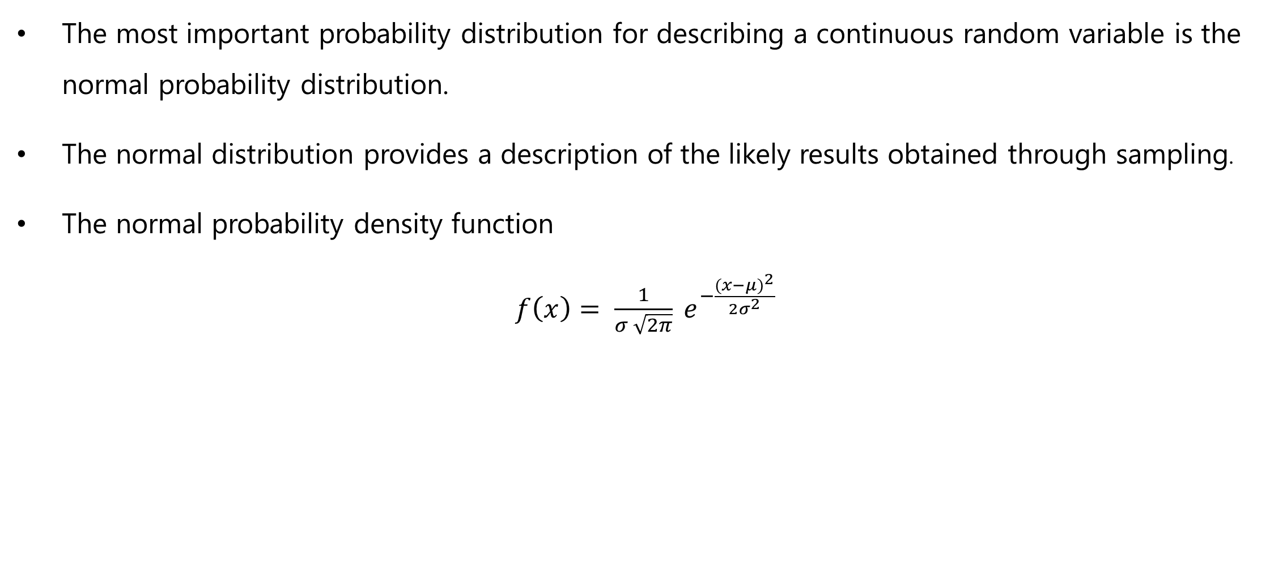
Normal Probability Distribution

Slide 25
Normal Curve
The form, or shape, of the normal distribution is illustrated by the bell-shaped normal curve
We make several observations about the characteristics of the normal distribution.
The entire family of normal distributions is differentiated by two parameters: the mean µ and standard deviation σ.
The highest point on the normal curve is at the mean, which is also the median and mode of the distribution.
The mean of the distribution can be any numerical value: negative, zero, or positive
The normal distribution is symmetric. The tails of the normal curve extend to infinity and theoretically never touch the horizontal axis. Because it is symmetric, the normal distribution is not skewed; its skewness measure is zero.
The standard deviation determines how flat and wide the normal curve is.
Probabilities for the normal random variable are given by areas under the normal curve. The total area under the curve for the normal distribution is 1.

Slide 26
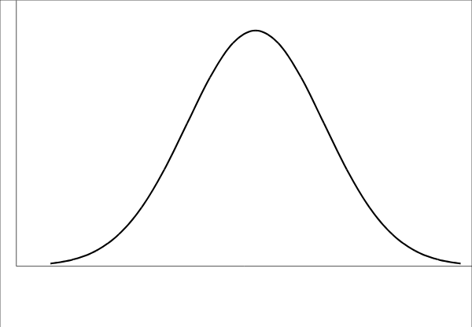
Normal Curve
7. The percentage of values in some commonly used intervals are:
68.3% of the values of a normal random variable are within plus or minus one standard deviation of its mean.
95.4% of the values of a normal random variable are within plus or minus two standard deviations of its mean.
99.7% of the values of a normal random variable are within plus or minus three standard deviations of its mean
68%
95.5%
99.75%
-3σ
-2σ
-1σ
μ
1σ
2σ
3σ

Slide 27
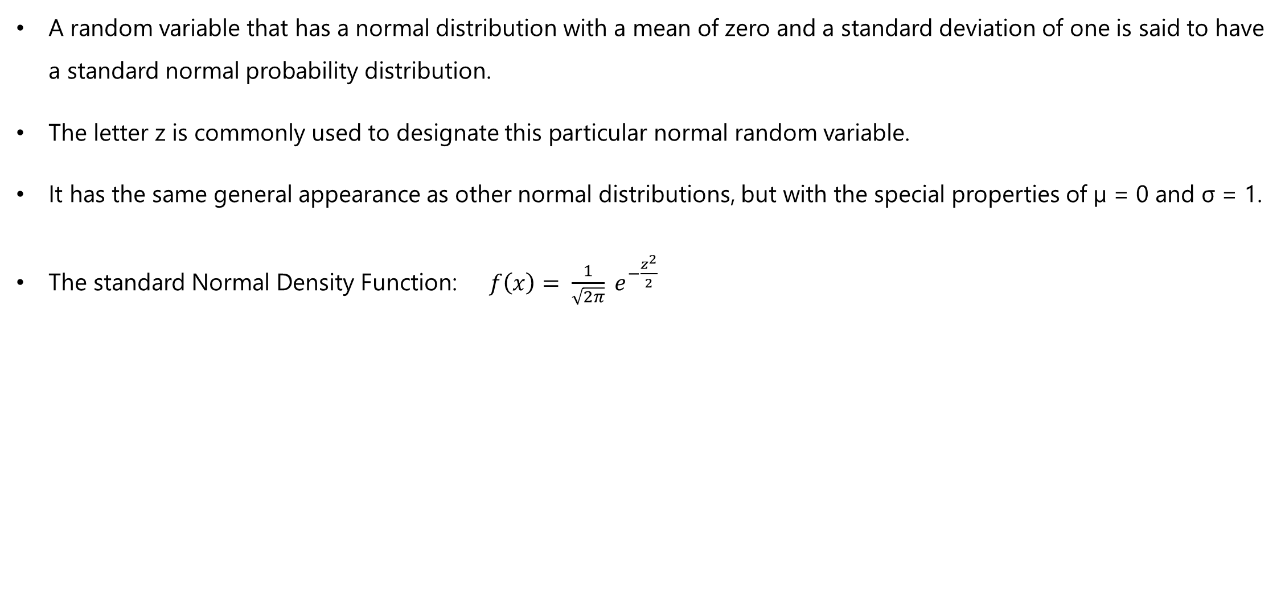
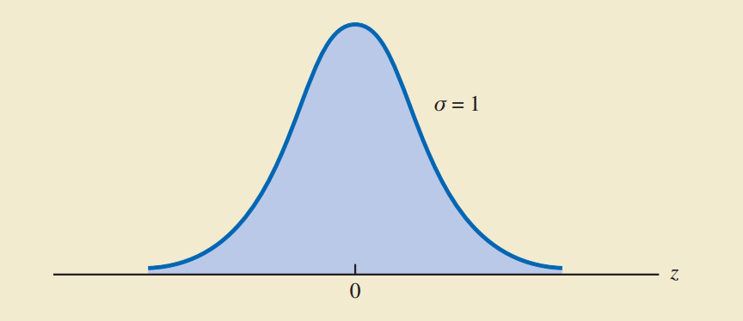
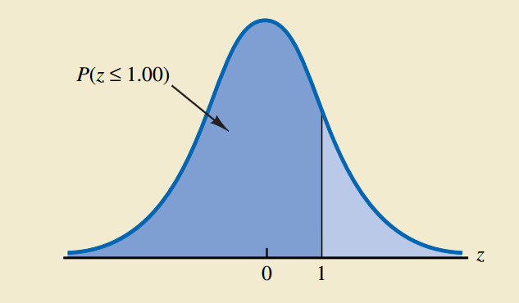
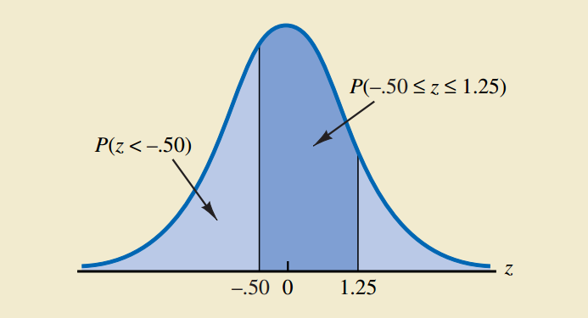
Standard Normal Probability Distribution

Slide 28
Standard Normal Probability Distribution
Using standard normal distribution we can find out probability that z assumes certain value.
z | Area = Probability
< 1 | 0.3413 + 0.5 = 0.8413
> 2 | 0.5000 – 0.4772 = 0.0228
1 < z < 2 | 0.4772 – 0.3413 = 0.1359
< -2 | = > +2 = 0.5000 – 0.4772 = 0.0228
-1 < z < -0.5 | = 0.5 < z < 1 = 0.3413 – 0.1915 = 0.1498
-1 < z < 1.5 | = z < 1 + z < 1.5 = 0.3413 + 0.4332 = 0.7745
z > 2.5
0.5 < z < 2.5
-1.5 < z < 1.5

Slide 29
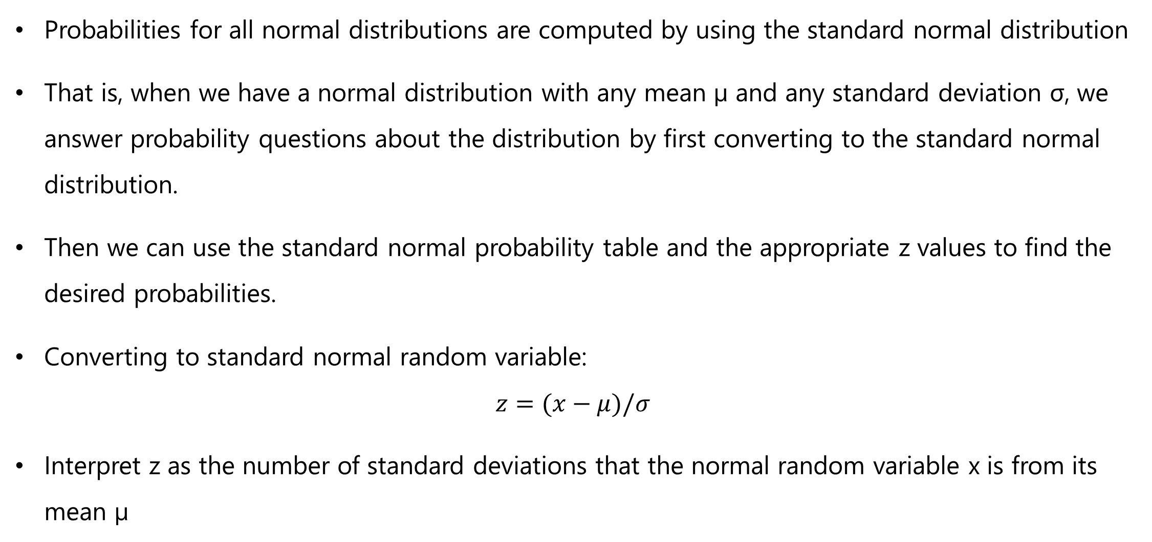
Probabilities for any Normal Probability Distribution – z Scores

Slide 30
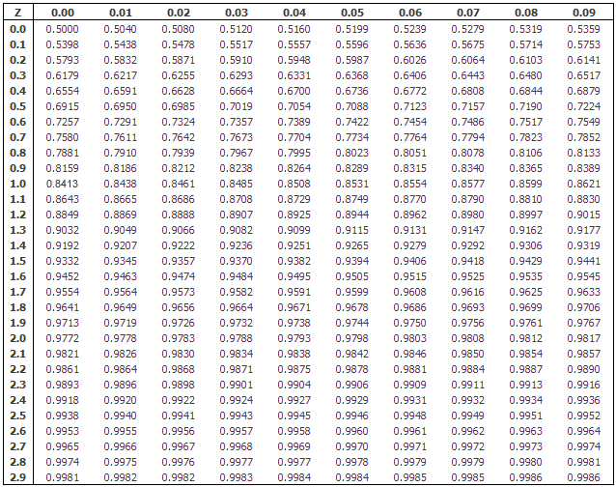
Normal Distribution Table

Slide 31
Thank You

